Slide 1
Decolonising (non-)violence
Dr Yin Paradies BSc MMedStats MPH PhD
Wakaya man
Distinguished Professor of Race Relations
Faculty of Arts and Education, Deakin University

Slide 2
Detrimental violence
Ends justifying means and other ‘necessary’ evils
Correction, contraction, contest, coercion, control
Willful ignorance, abuse, gas-lighting and oppression
Complicities, disguises, deceits, demonisations / idealisations, projections, silences and weaponisations
Assumptions, aversions (dislikes), addictions (likes)
Traumas (hurt people/cultures hurt people/cultures)

Slide 3
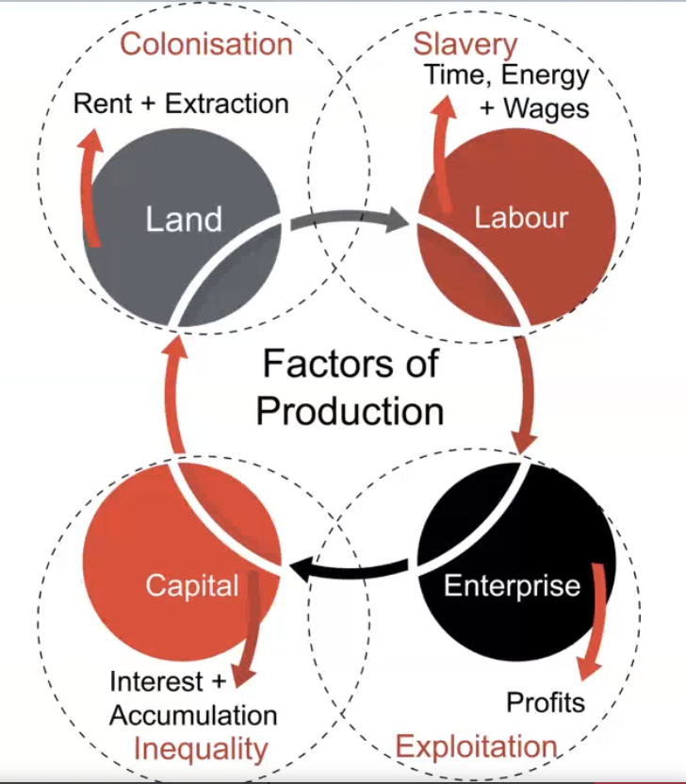
Notes:
Ingrid Burkett

Slide 4
Modernity’s violence
Abstraction, alphabetisation, anonymity, atomisation
Destitution, disassociation, disposability, exploitation
Force, instrumentalisation, (in)toxification, modularity
Objectivity, paternalism, perfectionism, power over
Quantification, rationalism, reductionism, scheduling
Standardisation, systemisation, scalability, urgency
Valuation, violation, virtualisation and weaponisation

Slide 5
Thinking as violence
We justify violence when we cut ourselves off from the wisdom, knowing and empathy of our bodily feelings, intuitions, instincts, sensations, vibrations
What if, instead, we attended to qualities of attention, emergent patterns, minutiae of our surroundings and tangible responsiveness to what IS here and now
Non-violence is a letting go of mastery, arbitration, correctness and progress; we must surrender our need to be certain, right and good (Lawson 2021)
Notes:
Anthea Lawson. 2021. The Entangled Activist: Learning to recognise the master's tools. Perspectiva Press.

Slide 6
Beyond modernity’s mastery
What if we stopped fixing, forcing and yoking the inherent vastness and radical incoherence of life to instead embrace the mystery of its unfoldment
To engage in emergences that spill away from our containment, outside our rational control, as caesuras without clear channels; eschewing the perpetual antagonism of resistance and the escape of refusal
Rather than passivity, non-violence is a receptive relinquishment that cultivates a conduc(t)ive context for channelling/catalysing change (Ewara 2023)
Notes:
Eyo Ewara. 2023. The Intersection of Black Studies and Continental Philosophy. Philosophy Today. 67(4): 749-771.
Eyo Ewara. 2023. For Estrangement: Queerness, Blackness, and Unintelligibility. Philosophy Compass 18 (3): e12897.

Slide 7
What is non-violence?
Care, courage, integrity, love, sacredness, vulnerability
Humility and honesty (with yourself and with others, when safe) while opening our hearts to those whose views and actions we profoundly object to
Emotional stability, relational maturity, intellectual discernment and intergenerational responsibility
Accepting ourselves unconditionally, just as we are, while staying wide open to growth; connection, conflict, conviviality, co-liberation and cooperation

Slide 8
(Non-)violence of Indigenous societies
Eccentricity/individuality (not individualism)/context sensitivity (no inherently oppressive abstracted rules)
Inter-dependence rather than (in)dependence within layered nested distributed authority and leadership
A prefigurativity in which the ends never justifies the means; instead, the means are the ends
Ritualised, ceremonial and distributed (predominately physical) ‘violence’ rather than modern intense-ubiquitous emotional, physical and spiritual violence

Slide 9
What is fierce egalitarianism?
A relational equilibrium of autonomy among inter-dependent beings free to choose and act while remaining immersed in deep connection / obligation with each other (i.e., no command obedience system)
Downward levelling peer norms (violence?) such as teasing, banter, mockery, ridicule, shunning, ostracism etc. which balance against over inflated egos
Guidelines for behaviour linked with profound respect for the wellbeing of other human and more-than-human entities, beings, spirits, forces etc.
Notes:
Locating An Indigenous Anarchism by Aragorn! (2005)

Slide 10
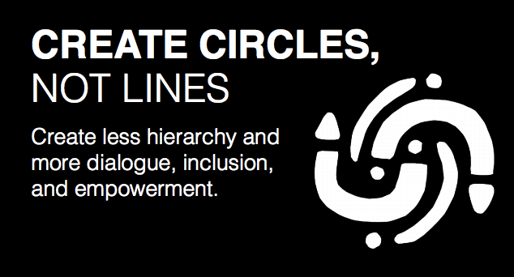
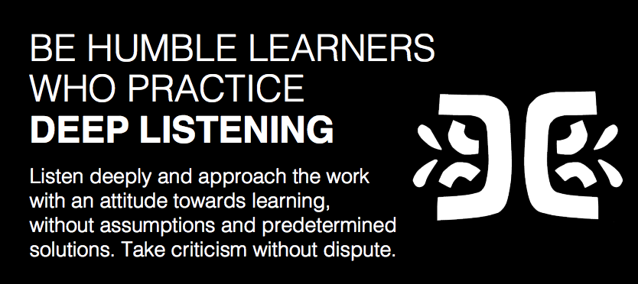

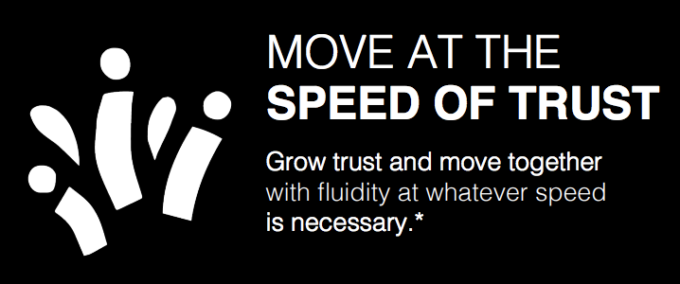

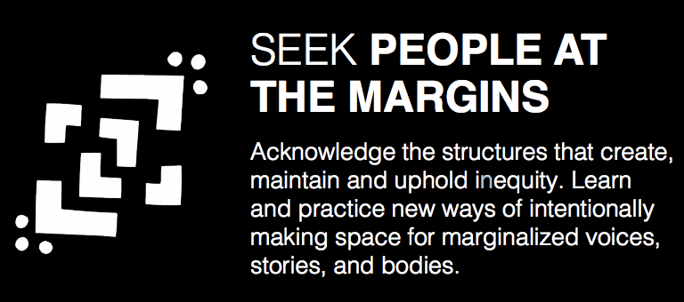
Nothing about us without us
Notes:
https://blackspace.wpengine.com/wp-content/uploads/2022/09/BlackSpace-Manifesto.pdf

