Slide 1
Challenging the top-down approach of Australian environmental law: AELA’s approach to the EPBC Act Review
Dr Michelle Maloney Australian Earth Laws Alliance www.earthlaws.org.au

Slide 2
My presentation this evening
Brief sketch of who AELA is, and our underlying philosophies and objectives
How we will be responding to the EPBC Act Review

Slide 3
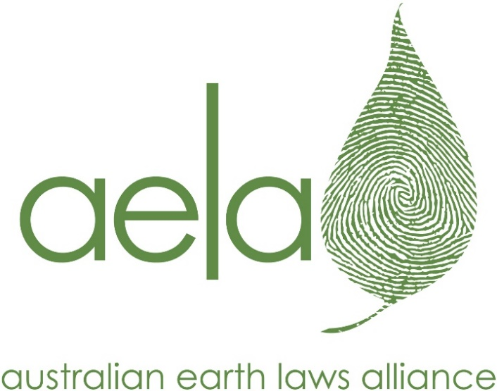
About AELA
Created in 2012
Mission: to increase the understanding and practical implementation of Earth centred governance – law, economics, education, ethics and the arts
“Earth jurisprudence”
AELA is focussed on creating systems change
multi/trans disciplinary

Slide 4
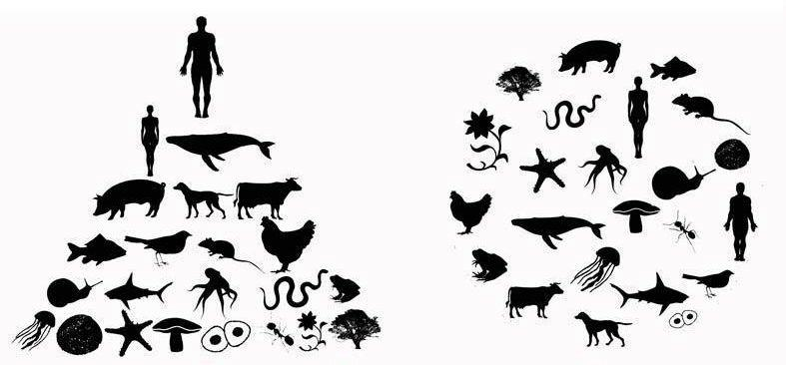
Earth jurisprudence calls for us to examine the root causes of the current crisis and shift all our governance systems from human centred to Earth centred
Human centred
Earth centred

Slide 5
Industrial society
has failed to manage its relationship with the living world and its relationships between people

Slide 7
AELA’s five core themes of work
Education
Earth Arts
Cross cultural – Future Dreaming
Rights of nature
Community rights
Ecocide
New Economy
Science
Ethics First Nations
Ecospirituality
Alternative legal, economic & political models
GreenPrints
New Economy Network Australia
Australian Peoples
Tribunal
Earth Democracy supporting
community
Organisations
Ecological justice
Governance
International networks

Slide 8
Our concerns - failure of ‘environmental governance’
Human centredness – nature as property
Pro-growth culture and governance systems
Government and corporate control of resources and information
Plutocracy – elite control – government, economics, laws and governance system
Top-down “standardized” approach to environmental law
Political processes and jurisdictions disconnected from physical realities
Flawed sustainability model (no ‘end game’, no ‘ecological limits’ or planetary boundaries’)
Patchwork quilt of ‘saving what’s left’
c/f to a goal of ecological health and regenerative society
Colonial culture/mindset and colonial legal system continues

Slide 9
Recognising the legacy of colonisation, and acting to address it

Slide 10
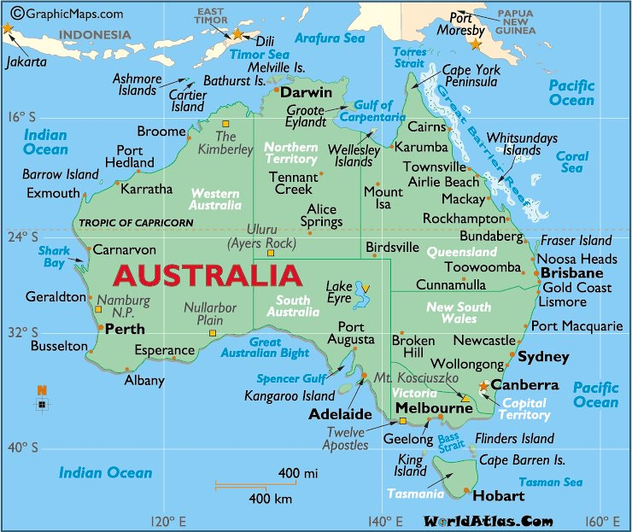

Slide 11
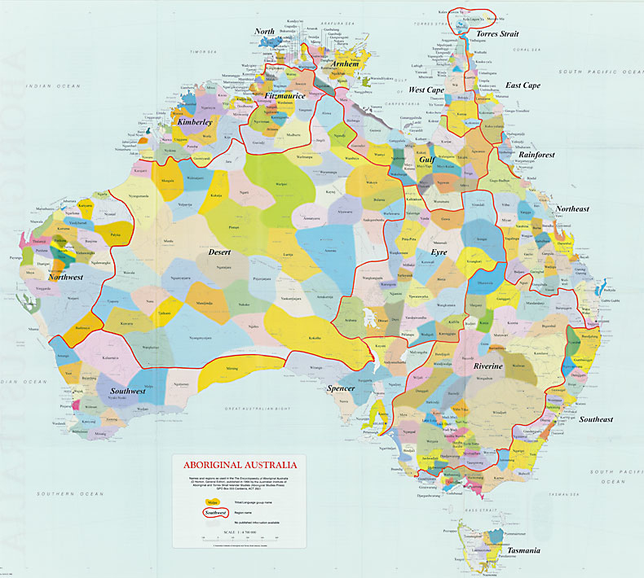

Slide 12
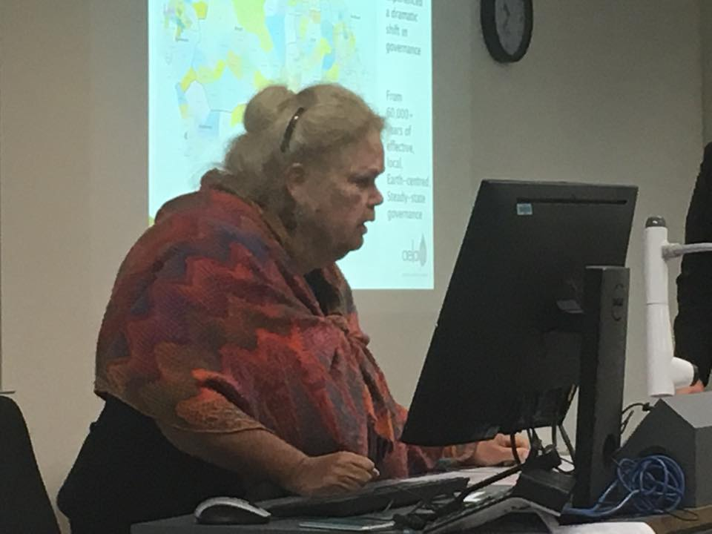
Aboriginal law and ethics
Adjunct Associate Professor, UQ
And Kombumerri
Person (Gold Coast)
Mary Graham

Slide 13
Relationist Ethos
In Aboriginal law, the two most important kinds of relationship in life are, firstly, those between land and people and, secondly, those amongst people themselves, the second always being contingent upon the first.
First laws – the land is the law
Second laws – kinship, custodianship, locality, balance, separating power and authority, everyone belongs, the landscape is alive

Slide 14
Future Law – Graham and Maloney
Embrace first laws as a foundation for all governance: The land is the law
Local custodianship
Ecological integrity
Ecological health
Template for our personal relationships
Reaffirm First Nations laws and sovereignty
Embrace relationist ethos
Personal ethics
Cultural ethics (translates into institutions, politics)
Earth centred economic systems
Redesign education systems
to Care for Country and Care for Kin
Redesign governance systems
separate power and authority
ensure balance
ensure everyone belongs
manage ego

Slide 15
Responding to the EPBC Act
Tier 1 Recommendations – The case for major reform (broad principles and approaches)
Tier 2 Recommendations – How the Governance System within which the Act operates and the Act can be reformed and improved
Tier 3 Recommendations – Recommendations for the principles of the review
Tier 4 Recommendations – Direct Responses to selected questions of the review

Slide 16
Tier 1 - Major reform – Earth jurisprudence, Earth Democracy, bioregional governance
(AELA’s Greenprints program)

Slide 17
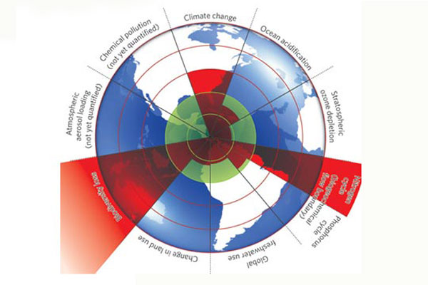
21st Century thinking about limits: Planetary Boundaries
Planetary boundaries is a concept involving Earth system processes which contain environmental boundaries
Proposed in 2009 (Nature) by Earth System and environmental scientists, led by Johan Rockstrom (Stockholm Resilience Centre) and Will Steffen (Australian National University)
Defines a "safe operating space for humanity"
In 2009 – 3 boundaries crossed; since 2015 – 4 boundaries crossed
The framework is based on scientific evidence that human actions since the Industrial Revolution have become the main driver of global environmental change.

Slide 18
Australia has 89 bioregions

Slide 20
419 sub-regions

Slide 21
Starting with the living world – the land is the law, the template for society
Ecocentric thinking
Connecting with place/country
Starting with what we love
Home, place, country Walking country
Maps, Arts, Creativity
Local knowledge Connectedness
First Nations Peoples’ law, culture, history contemporary work

Slide 22
What does bioregional ecological health look like in this place?
What does a healthy bioregion look like?
Need to engage with different knowledge systems Indigenous knowledge Modern History
Natural sciences
Core issues
Waterways
Vegetation
Soils
Biodiversity

Slide 23
Scenarios for bioregional health
How can we live here forever?
Different scenarios
Business as usual
Optimal
Okay
Drawing in scenario planning experts,
maps, artists

Slide 24
Nesting human society within a healthy bioregion
If we choose a healthy scenario – how can human activities fit within this unique place?
Questions about our values; our choices
Population
Consumption
Space
Lifestyle
Culture
Education
Human health
Redefining the good life

Slide 25
Create human economies that fit within social goals and eco-health
Economic activity Steady State
Ecological economics
Community economy
Regenerative economy
Questions
What does our
healthy bioregion
enable us to:
grow, water, eat cut down, import, farm, hunt
And how do we distribute it?
Social justice

Slide 26
Bio-regional governance
‘Retrofitting’ appropriate governance → laws, rules, ethics, institutions
Questions
How do we enshrine rules for healthy bio-regions into new governance?
How can we work within existing local/state jurisdictions but focus on bioregional health
How do we connect bioregion health with N.Parks, protected area management and so on

Slide 27
How do we make it all
happen?
Need to start somewhere
People start from different places, all flows together We can offer workshops/sessions/ mentoring:
About ecocentrism
Bioregional knowledge
Connect with other initiatives
Connect with existing NRM plans
Map the scenarios
Map the economic options Identify the ‘tweakables’
Identify the governance, systems and specific changes
Identify advocacy and campaign work

Slide 28
Tier 2 Recommendations – How the Governance System within which the Act operates and the Act can be reformed and improved
Within Federal Structure - Adopt an Earth Centred and Community Governance Approach as the foundation for environmental governance

Slide 29
Responding to the EPBC Act
Tier 1 Recommendations – The case for major reform (broad principles and approaches)
Tier 2 Recommendations – How the Governance System within which the Act operates and the Act can be reformed and improved
Tier 3 Recommendations – Recommendations for the principles of the review
Tier 4 Recommendations – Direct Responses to selected questions of the review

Slide 30
Thank you convenor@earthlaws.org.au www.earthlaws.org.au

